Slide 1
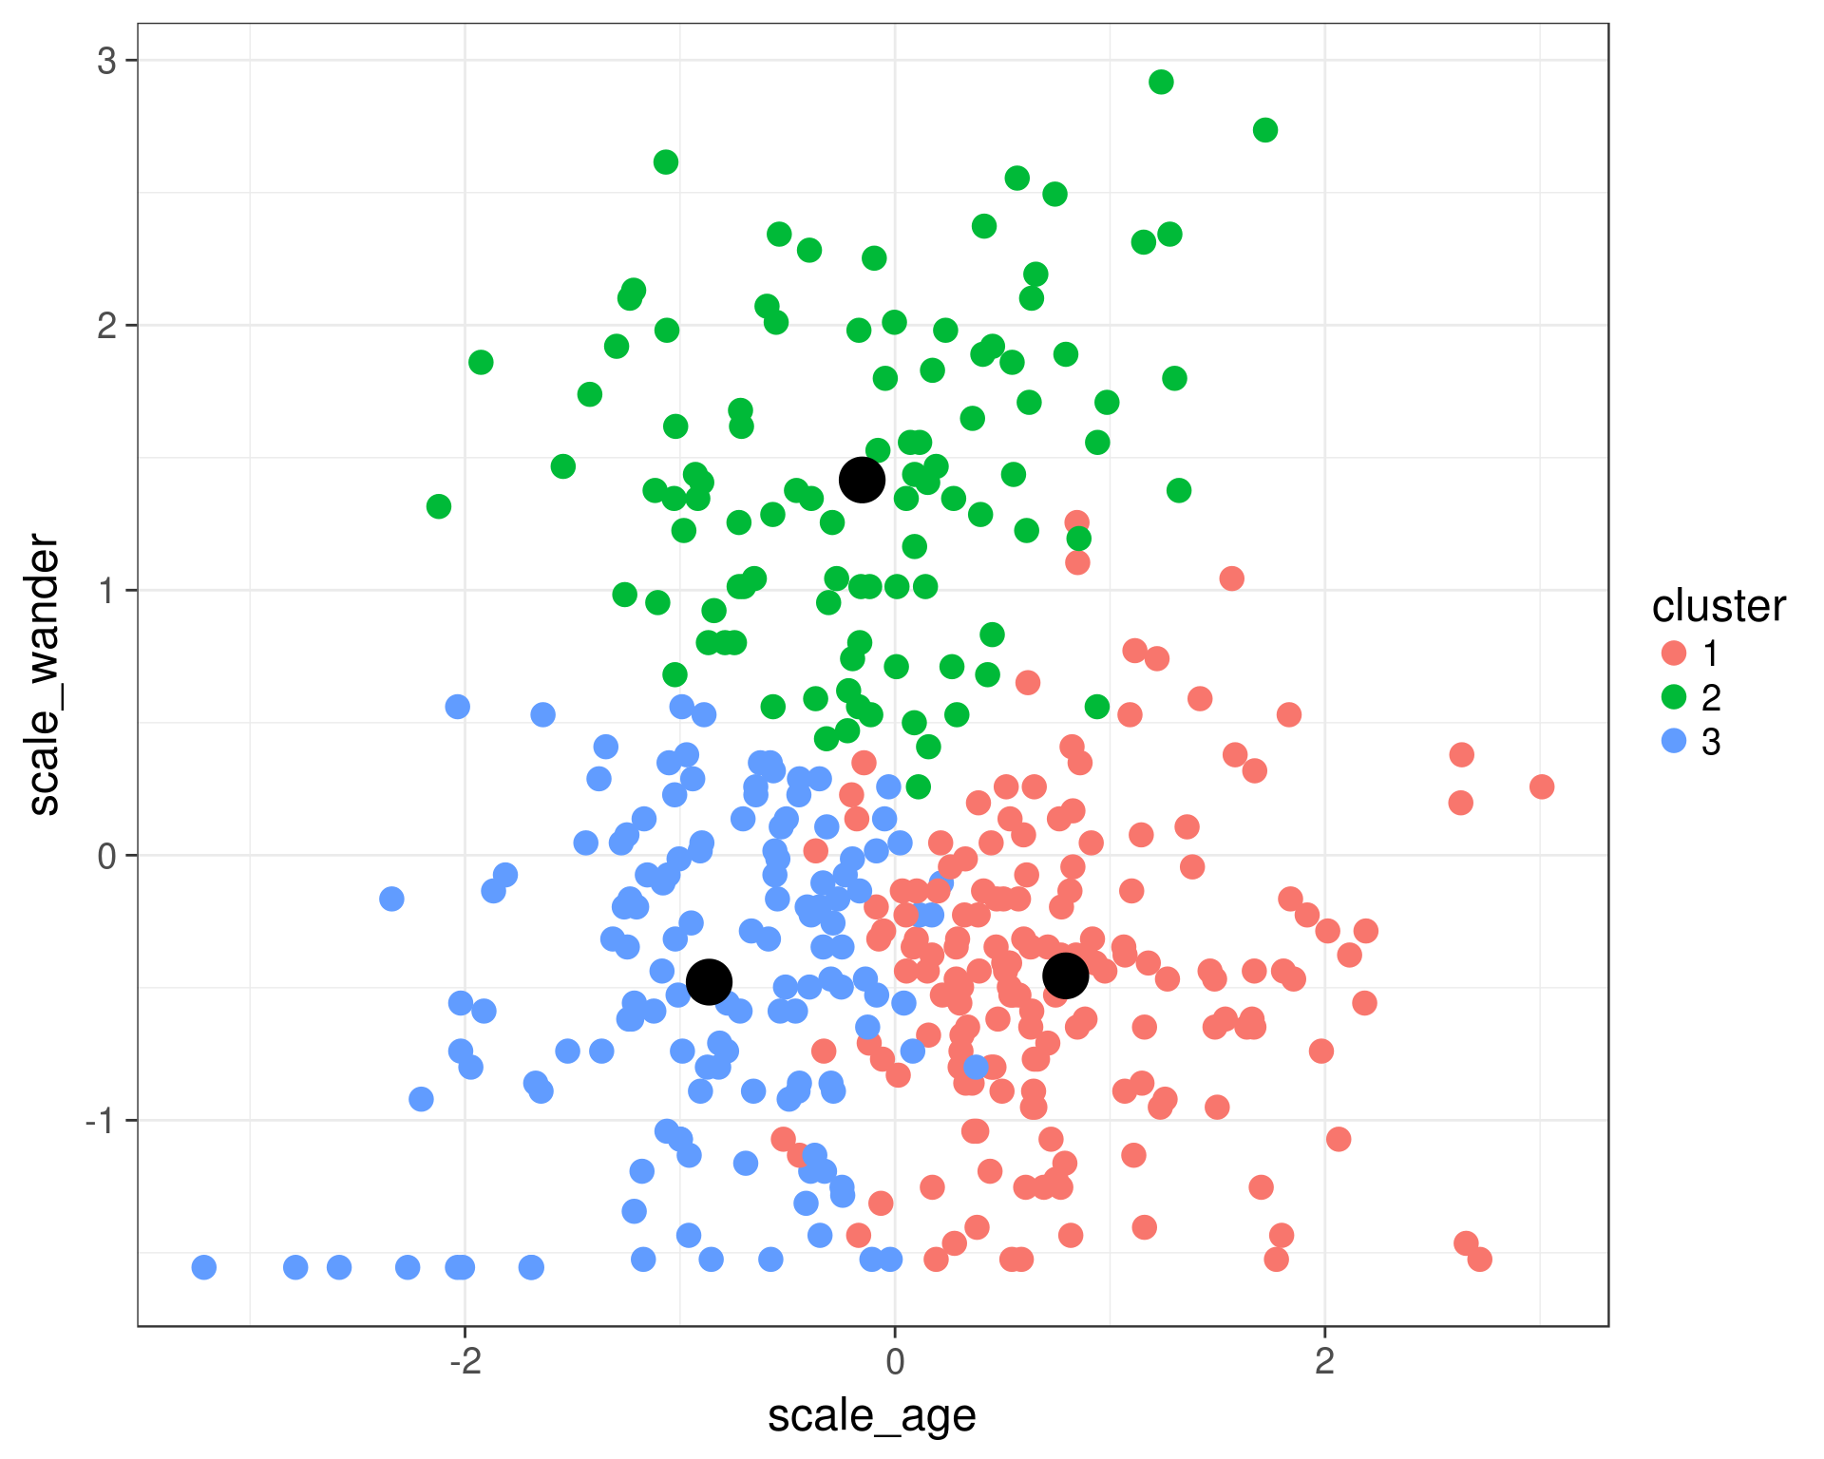
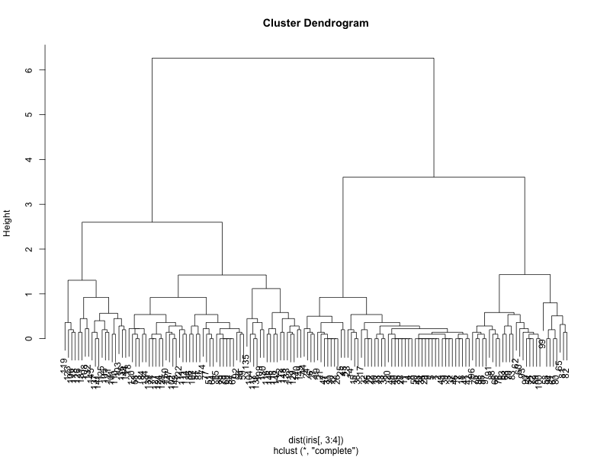
Week 11:Clustering and the final take home project
Geog4300: Shannon

Slide 2
Wrapping up!
Two final topics this week not used in labs:
Clustering: k-means/hierarchical cluster analysis
Spatial autocorrelation
Notes:
Alternative hypothesis is usually what you’re trying to prove.

Slide 3
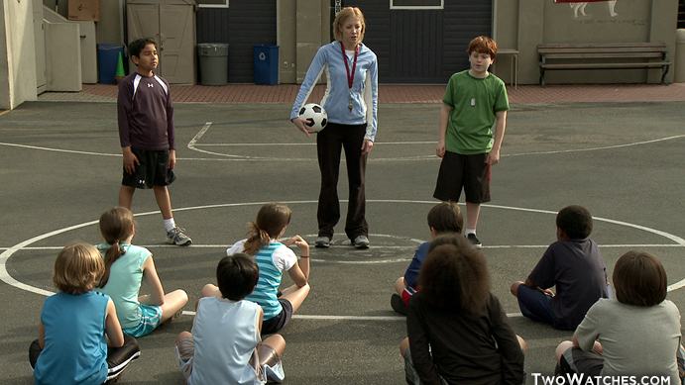
K-means
Picks a set number of “seeds” and then groups based on similarity.
Notes:
Alternative hypothesis is usually what you’re trying to prove.

Slide 4
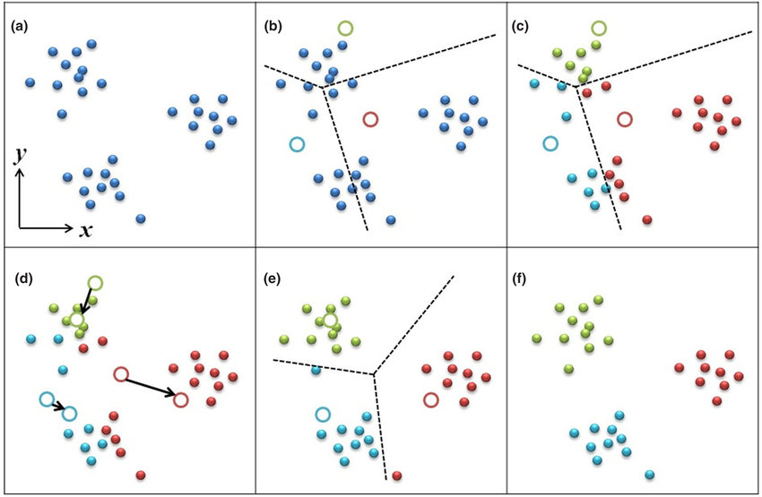
K-means
Highly dependent on the initial “seeds”
Notes:
Alternative hypothesis is usually what you’re trying to prove.

Slide 5
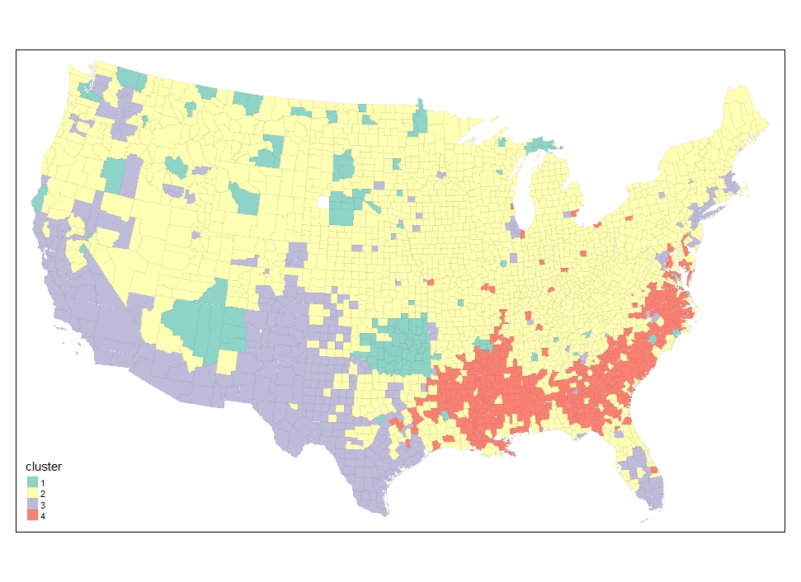
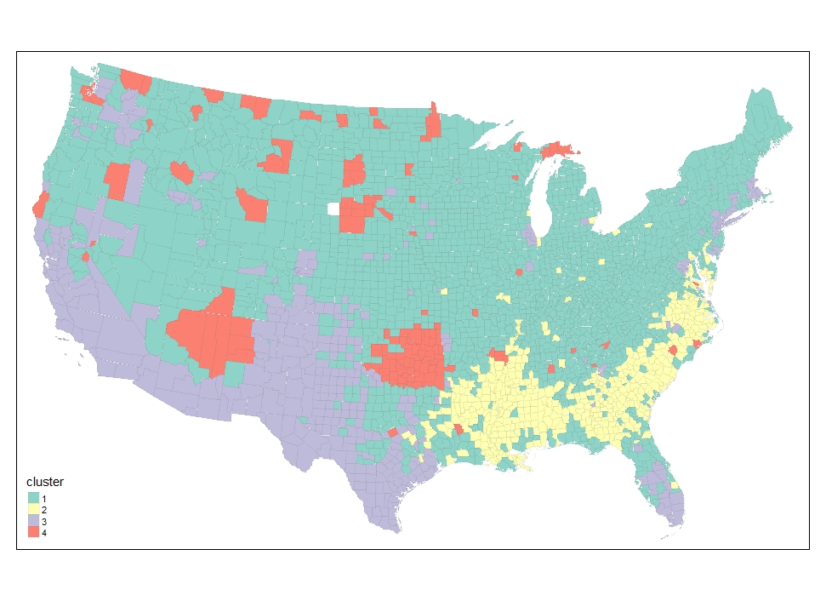
Let’s look at our county data!
Two cluster maps just based on the race/ethnicity variables
Notes:
Alternative hypothesis is usually what you’re trying to prove.

Slide 6
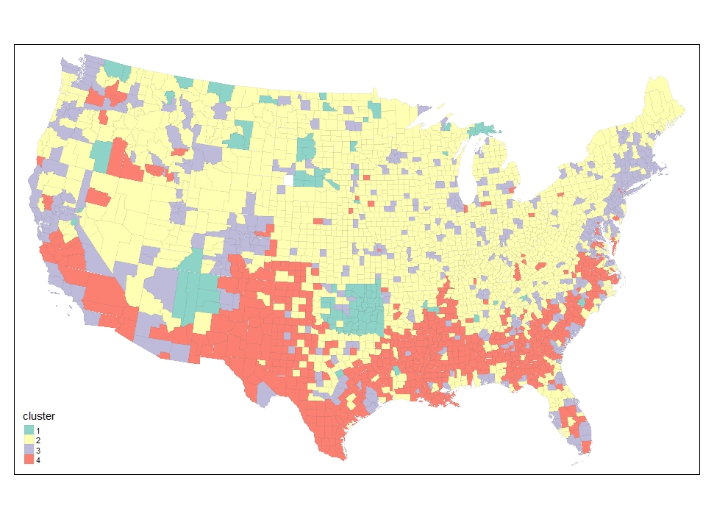
Let’s look at our county data!
Now let’s add in education variables
Race/ethnicity
Race/ethnicity + ed attainment
Notes:
Alternative hypothesis is usually what you’re trying to prove.

Slide 7
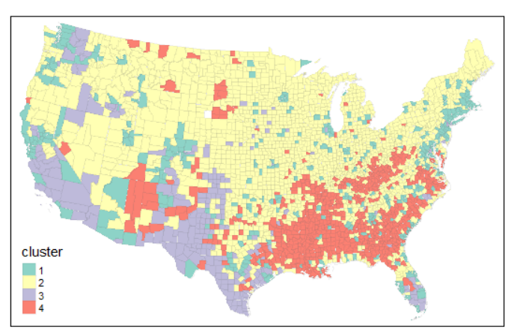
Let’s look at our county data!
Now let’s add in nativity variables
Race/ethnicity + ed attainment + nativity
Race/ethnicity
Race/ethnicity + ed attainment
Notes:
Alternative hypothesis is usually what you’re trying to prove.

Slide 8
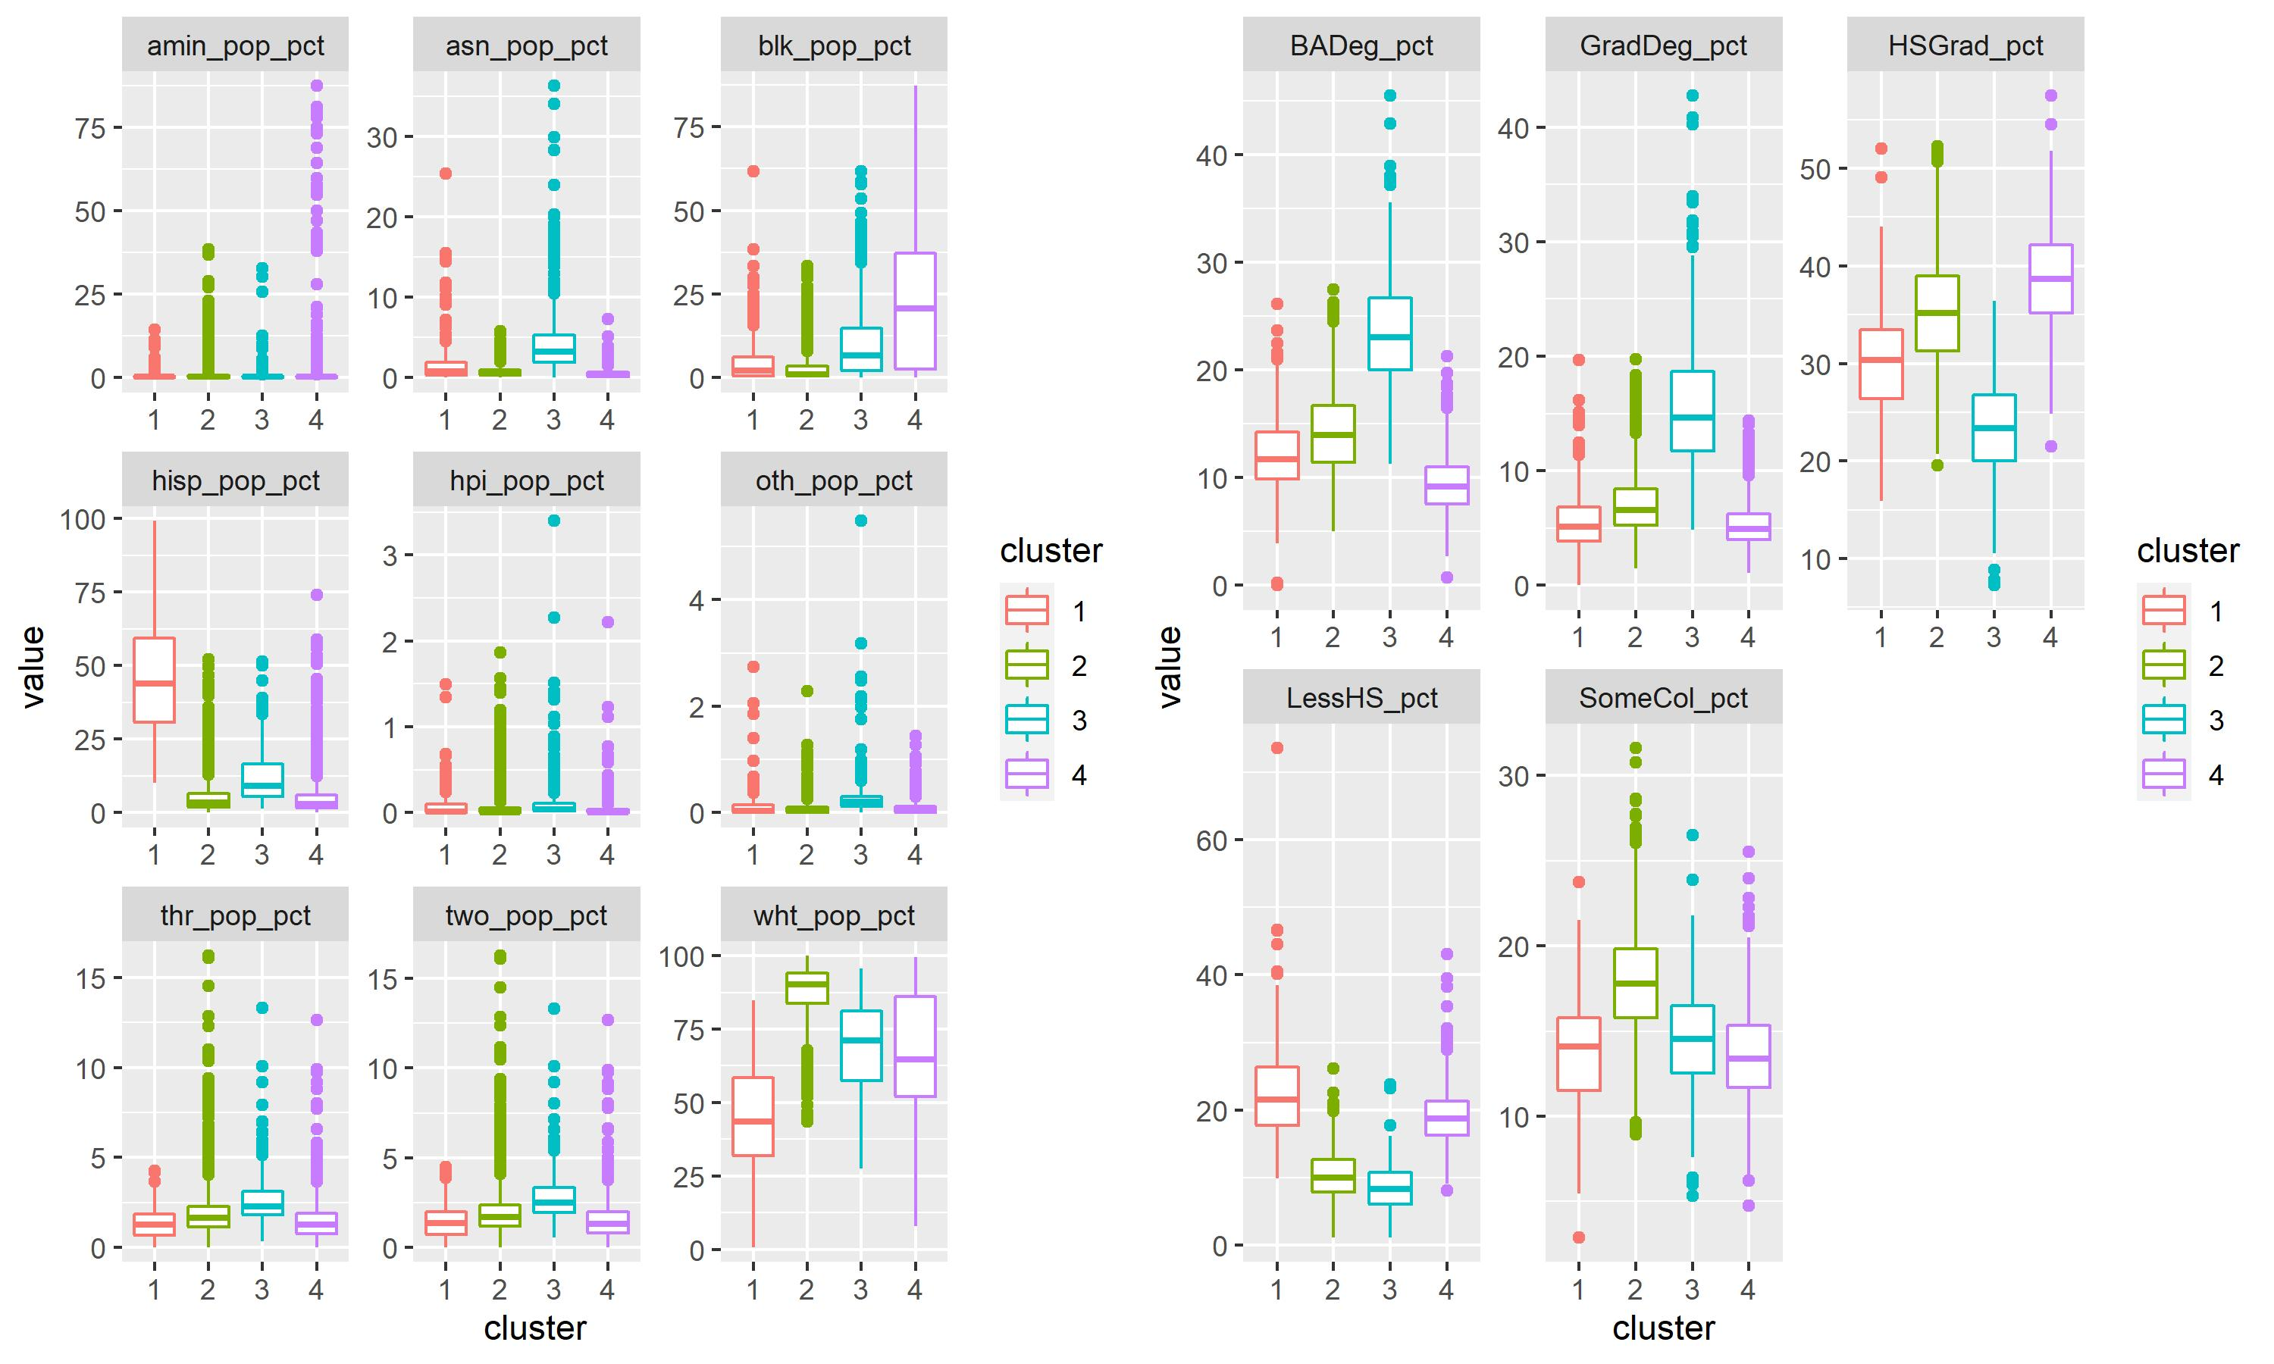
What do these clusters mean?
Ed + ethnicity
In groups:
Take one of these clusters and identify what makes it distinctive compared to the three others.
How would you title it?
Notes:
Alternative hypothesis is usually what you’re trying to prove.

Slide 9
Do these clusters make sense?
Race/ethnicity + ed attainment
Notes:
Alternative hypothesis is usually what you’re trying to prove.

Slide 10
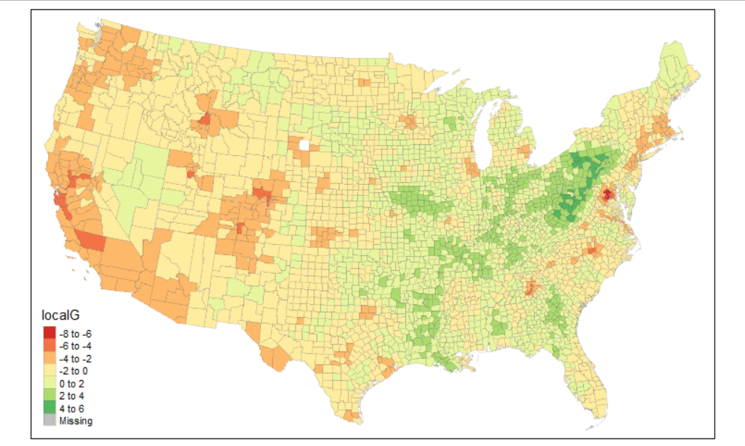
Clusters are different from spatial autocorrelation
Clusters:
Observations grouped by similarities across multiple variables
Spatial autocorrelation:
Neighboring areas with similar values for the same variable
HS Graduation is highest ed. attainment
Notes:
Alternative hypothesis is usually what you’re trying to prove.

Slide 11
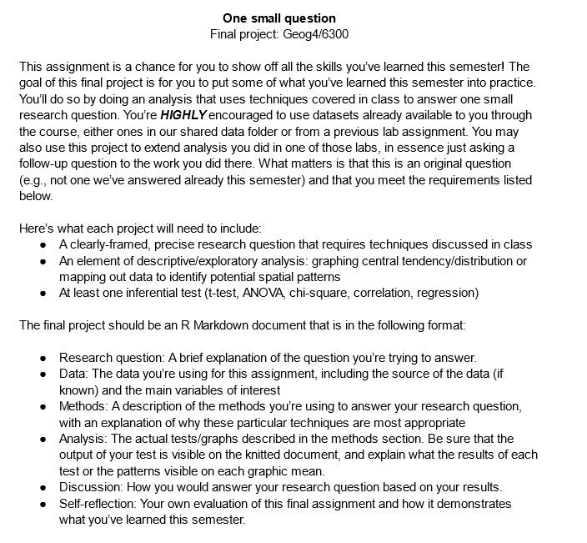
Your final project
Notes:
Alternative hypothesis is usually what you’re trying to prove.

Slide 12
What questions could you ask?
County-level census data
Yelp data for Charlotte
Daymet climate data (county level)
Presidential election data (county level)
Current population survey data
Pollen data in the Midwest
Date of last spring frost in the Southeast
Tornado locations in the Southeast
Brainstorm at least FIVE potential research questions.
Notes:
Alternative hypothesis is usually what you’re trying to prove.

Slide 13
What questions could you ask?
County-level census data
Yelp data for Charlotte
Daymet climate data (county level)
Presidential election data (county level)
Current population survey data
Pollen data in the Midwest
Date of last spring frost in the Southeast
Tornado locations in the Southeast
Pick one question. What steps would you need to follow to answer that question?
Notes:
Alternative hypothesis is usually what you’re trying to prove.

Slide 14
For next Tuesday:
Write a “proposal” that covers the first three sections of the final project. Tag me on Github when posted I will respond with feedback.
Notes:
Alternative hypothesis is usually what you’re trying to prove.

